Slide 1
Skills4Advanced Manufacturing
UNLOCKING THE INDUSTRIAL GREEN TRANSITION

Slide 2
VOCATIONAL TRAINING
UNIVERSITY EDUCATION
PERFORMANCE AREAS
PROJECTS WITH COMPANIES
TRAINING FOR EMPLOYMENT

Slide 3
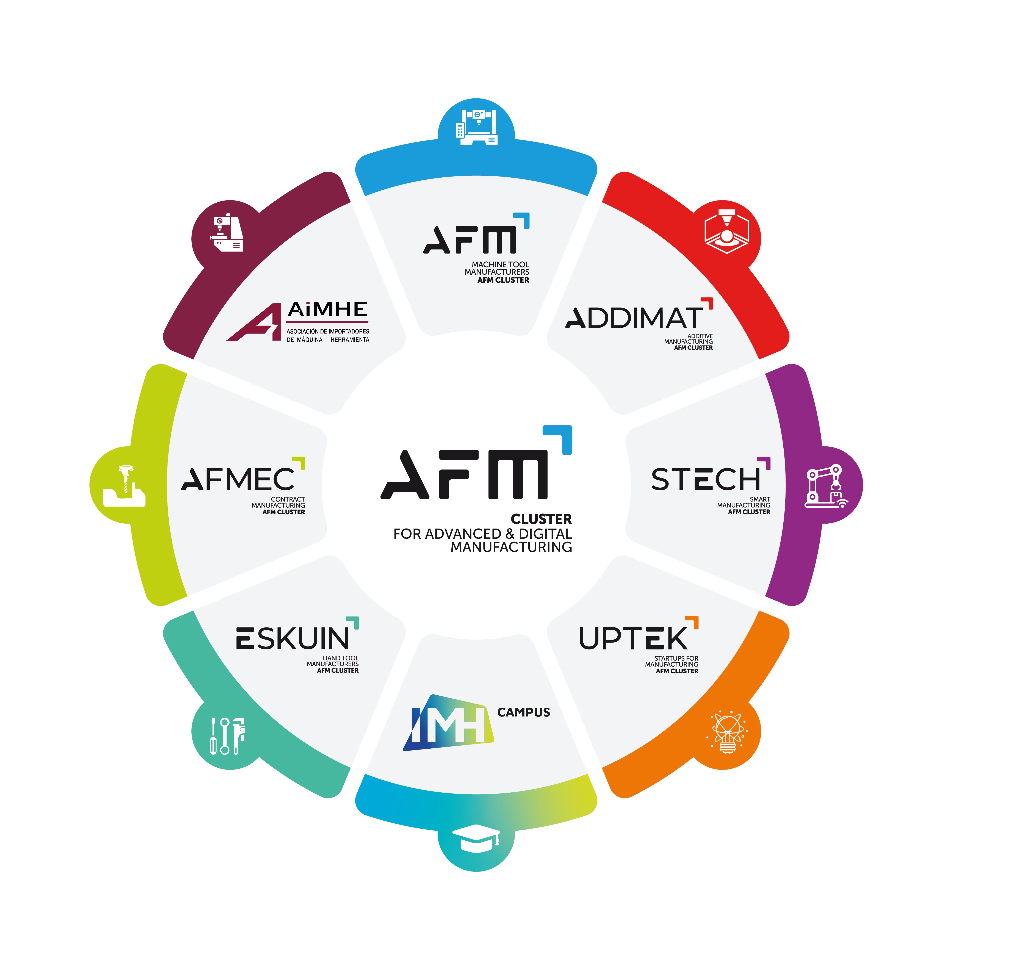
ASSOCIATED COMPANIES
+ 700
COLLABORATING MEMBERS
+ 90
AFM CLUSTER
BILLING
+ 3,500 mil.€
DIRECT EMPLOYMENT
+ 17,000

Slide 4
# ENVIRONMENTAL SUSTAINABILITY IN ADVANCED MANUFACTURING

Slide 5
AFM GREEN
TRANSITION, TRENDS, REGULATIONS
IMPLICATIONS FOR BUSINESS
Ensuring less waste is produced
Optimise end-of-life and life-cycle system
Use of clean energy
Eco-design
Selecting low impact materials and reducing material use
Quantify waste and optimise disposal
The company needs to take action and make as much progress as it can on sustainability. Even if it is not yet the norm and complies with current regulations, the suggestions will gradually become mandatory.

Slide 6
TRANSFORMATION
IMH CAMPUS STRATEGY
Digital-technological transition
/ energy transition
New skills and re-skilling.
Loss of jobs, generation of new ones, and transformation of many.
Need for change and innovation: scenario that requires transformation (digital, ecological) and special care for the person as the agent of these transformations.
Contexts favourable to lifelong learning that enable people to acquire the learning strategies and key competences necessary for business and personal development.
Institutional Approach
Training
Rich ecosystem and complex challenge
SME ecosystem
Multidimensional constraints

Slide 7
INSTITUTIONAL APPROACH
Circular economy project
Corporate environmental footprint
ISO 14001 / energy audit 2020
Investments in installations for a smarter and more efficient building
Photovoltaics, industrial domotics, presence detectors,...

Slide 8
TRAINING
AGENDA 2030 STRATEGY
&
CONTRIBUTION TO THE SDGs
A2030 STRATEGY
Each year a theme: RESPONSIBLE PRODUCTION AND CONSUMPTION
Eco-representatives per group: communication, proposals, diagnosis, awareness-raising actions, recycling,...
Getting to know other European experiences
Knowledge/improvement of subjects:
Design for environmental sustainability - Sustainable development. - Design of the life cycle of products; use and end-of-cycle phases.
Additive Manufacturing
Incorporation of sustainable production into learning challenges.

Slide 9
TRAINING
STEAM Active: generate multidisciplinary teaching and learning sequences for engineering courses.
All STEAM interventions will take into account environmental impact, sustainability and the circular economy, it will increase students' awareness of these issues and also bring their learning closer to more real contexts.
Example: There is a specific company that performs the machining of a part in three different machining centres. After analyzing the specifications of each process, it analyzes the most competitive based on the following criteria: the energy consumption, the efficiency of the machine, the speed of the process, the environmental impact and the economic impact. The Steam interventions therefore will allow students to address and solve real problems of engineering work, helping them to master and select a multitude of specific science and engineering practices and integrates the environmental and economic point of view throughout the process.

Slide 10
THE TRAINING
THAT INDUSTRY
IS DEMANDING
SHAPE YOUR TALENT

