Slide 1


CECIMO - Skills4Advanced
Manufacturing
Job Creation and Local Economic Development 2023:
Bridging the Great Green Divide
LEED
GOOD JOBS, GREAT PLACES

Slide 2





Bridging the Great Green Divide
Lessons from past transitions
The way forward: local actions for a green future
The green transition and jobs, what do we know?
Implications for local jobs, skills and economic development

Slide 3



How can we measure green jobs?
Green jobs can be classified in two ways
Our approach is bottom-up.
We measure jobs with green tasks for regions across 30 OECD countries.
Industry/Sector
Occupations
Industries/GHG
Tasks or skills
Top down Bottom up
Main advantages:
  Captures regional/local information
  Includes the entire economy
  Directly linked to policy action: occupations -> tasks -> skills -> training

Slide 4
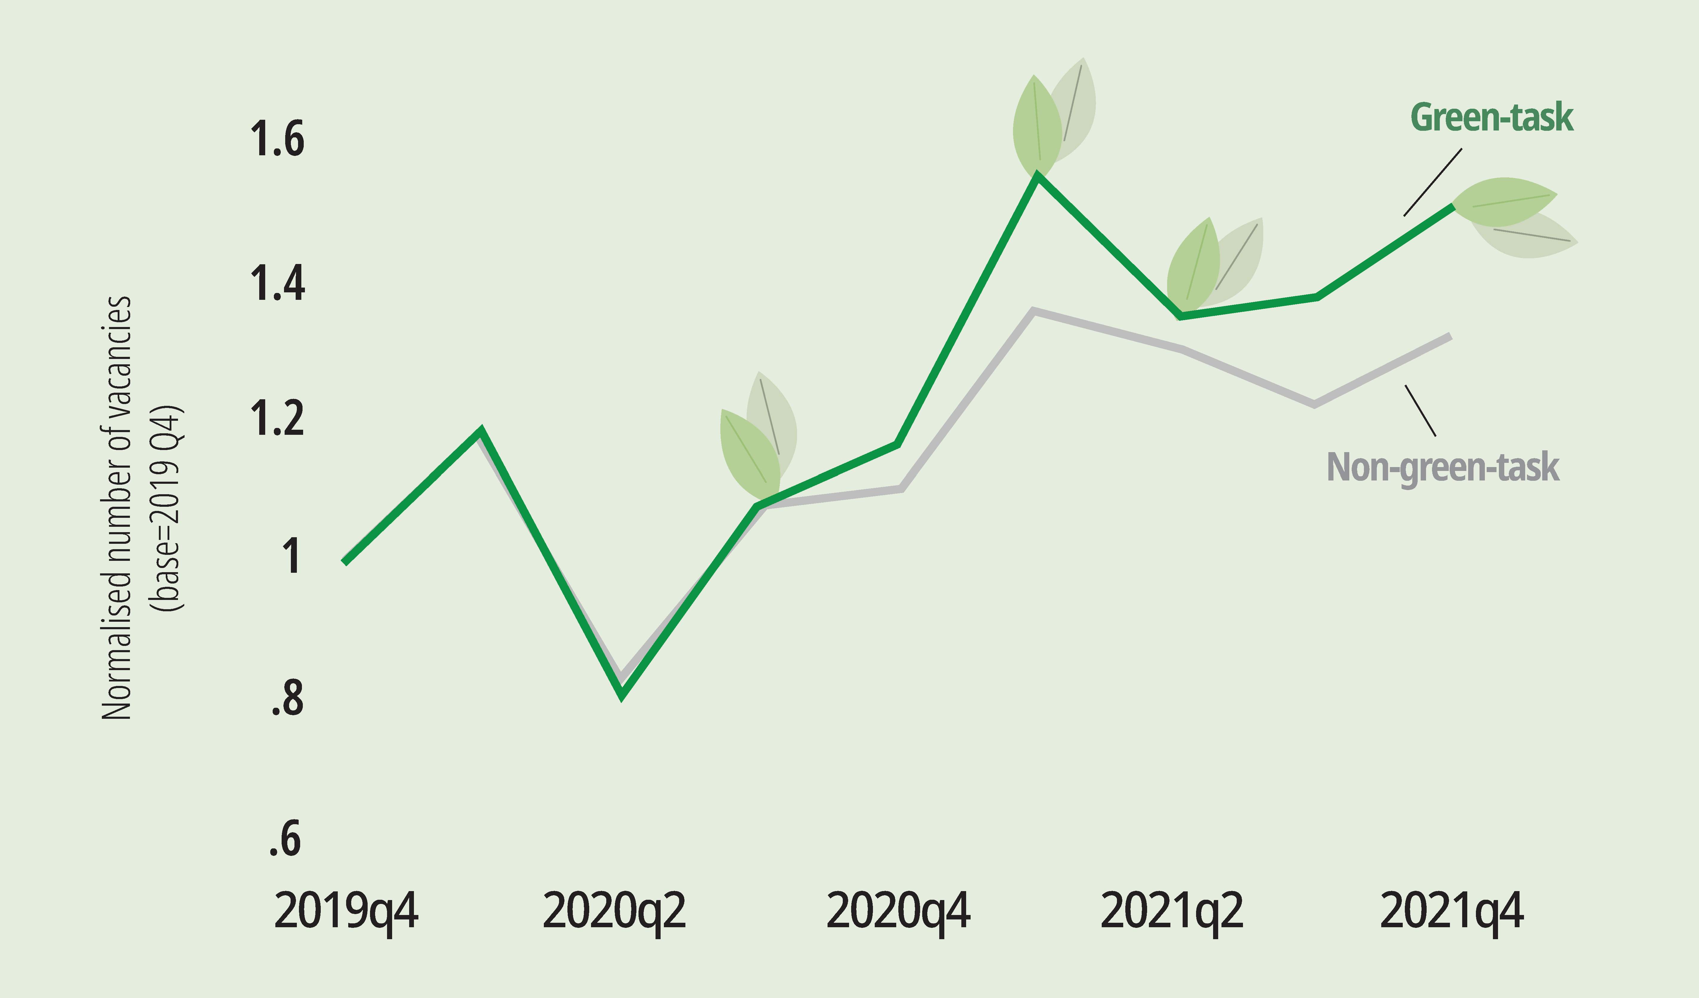
Local labour markets are greening… slowly
Little change in share of green jobs…
… but the demand is increasingly green
Around 18% of workers in the OECD have jobs with a significant share of green tasks, up from 16% a decade ago
Notes:
Slow pace of progress to net zero in terms of jobs.
30 percentage points more than non-green jobs in job posting analysis
Many of the regulatory matters that will trigger the demand for different skills are just hitting or haven’t hit yet

Slide 5
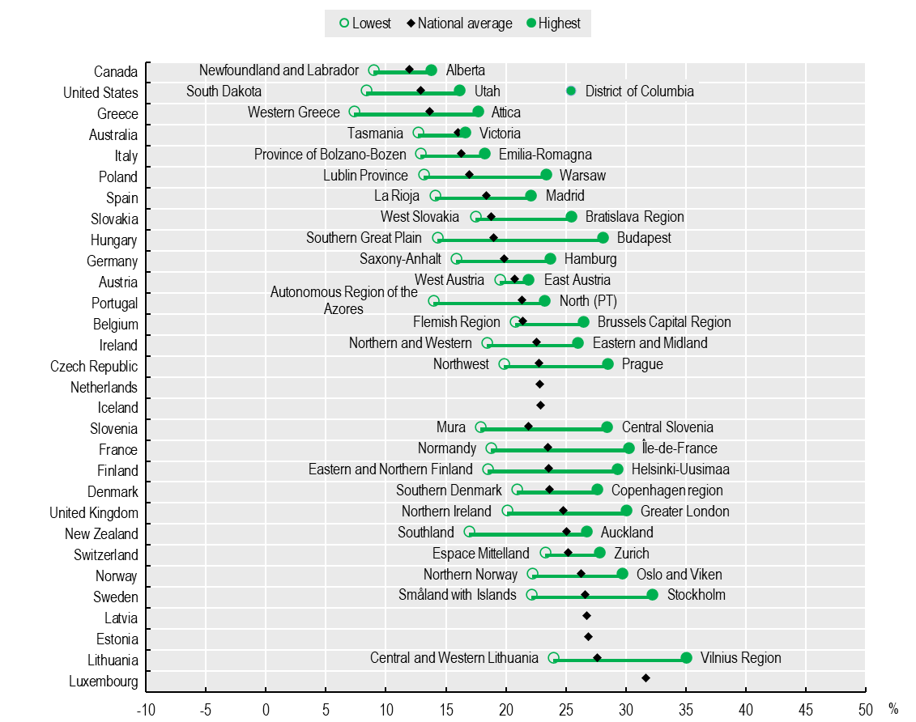
Divides across places: geography of green jobs
Share of green-task jobs
Green regional employment shares
Less than 10%
in South Dakota (US)
Western Greece
Newfoundland and Labrador (Canada)
30% or more
Stockholm, (Sweden) Oslo & Viken, (Norway) Île-de-France
Within-country disparity
5 pp or less
Austria, Australia, Switzerland, Italy
More than 10 pp
United States, France, Finland, Hungary

Slide 6
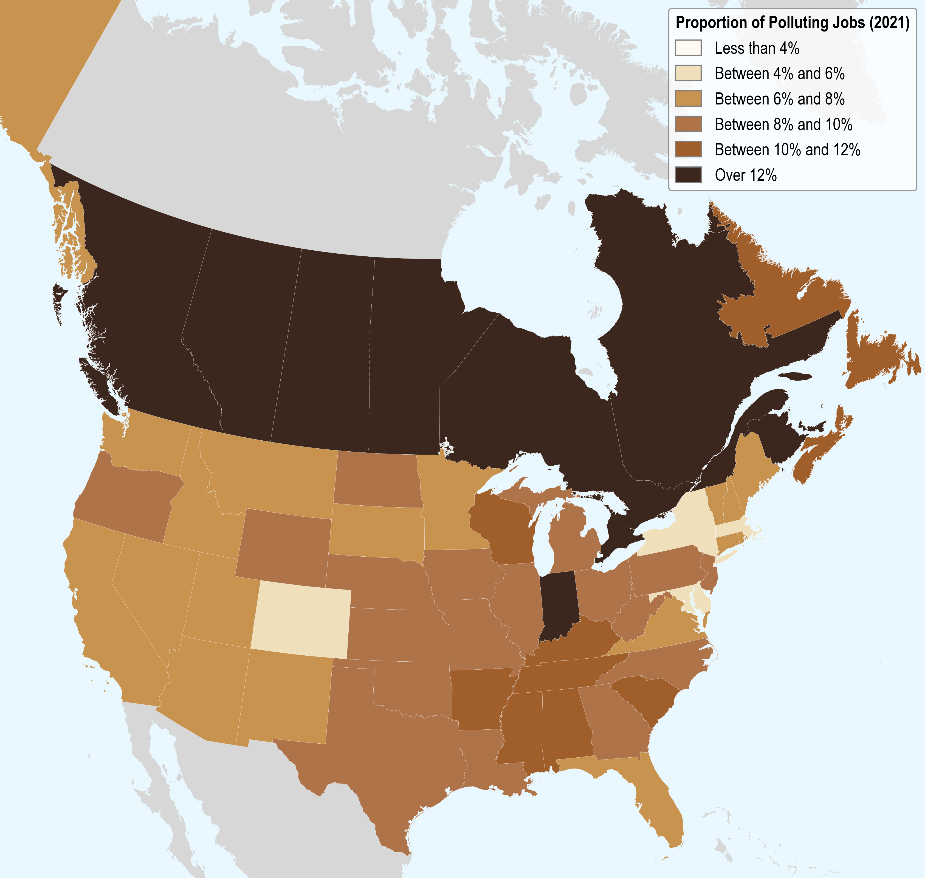
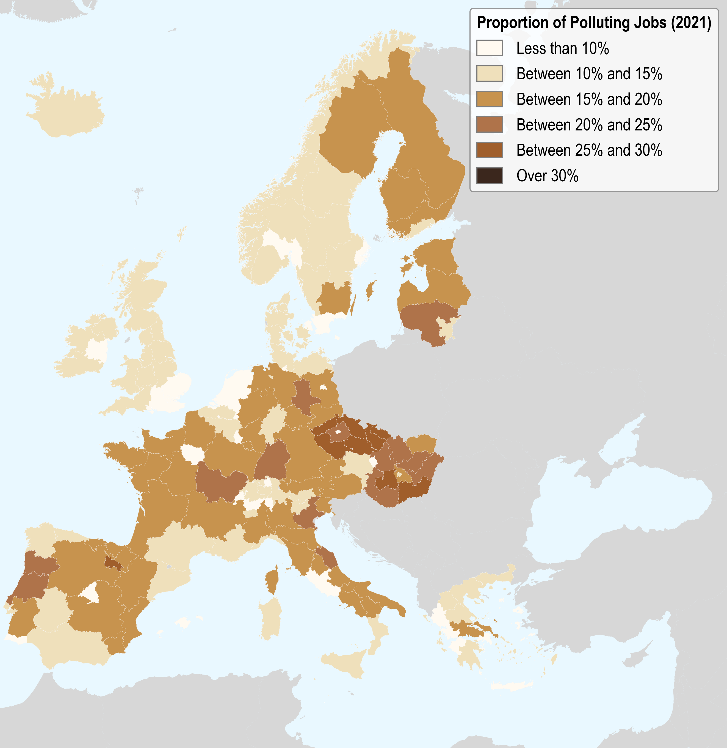
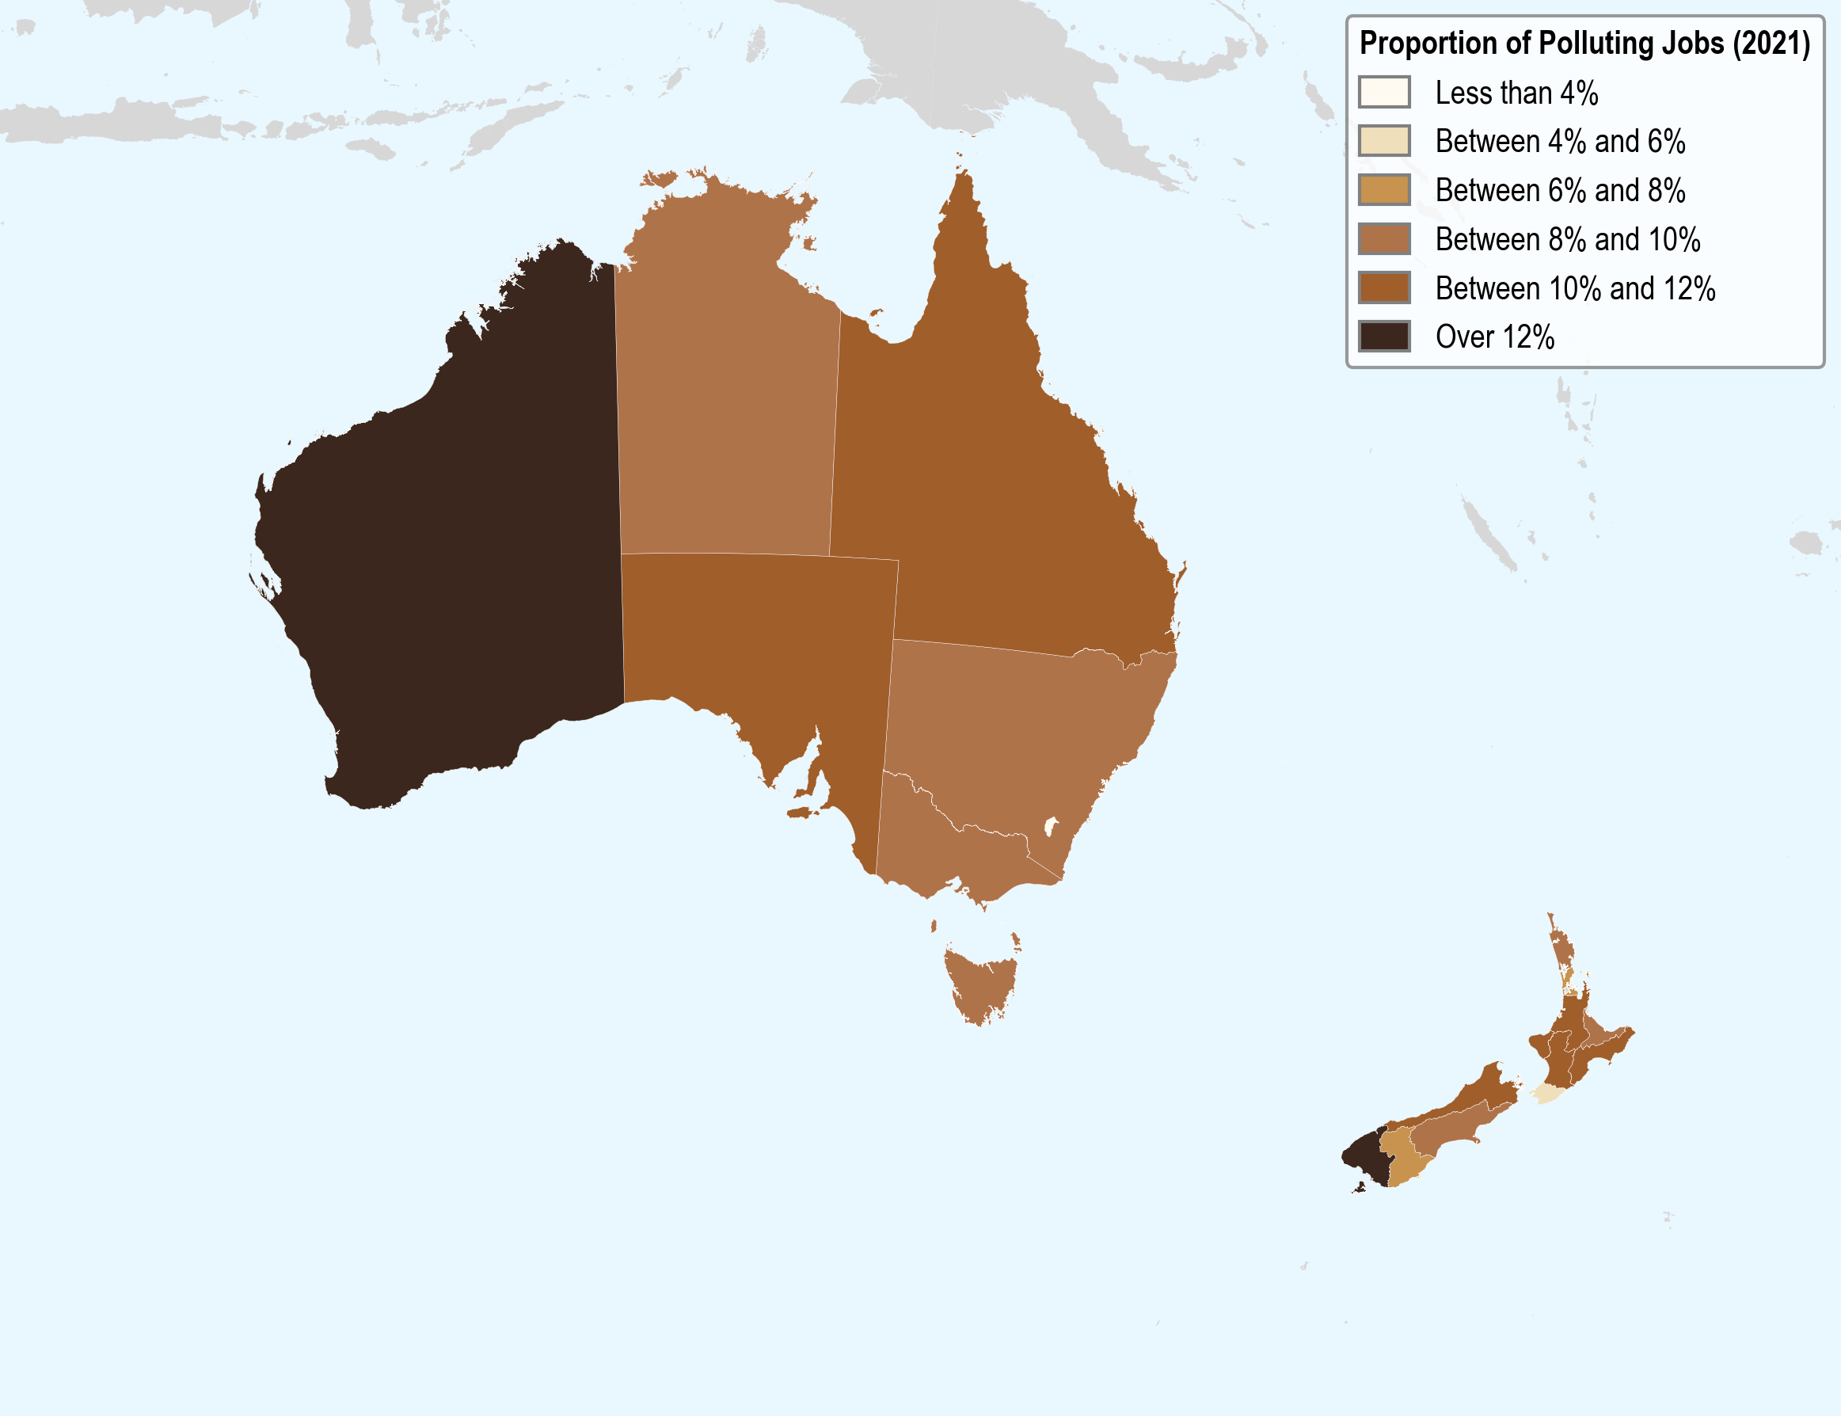

Divides across places: geography of “polluting” jobs
Regions relying on “polluting” jobs face greater risks of job losses
Share of polluting jobs
Australian Capital
Territory, Wellington (NZL), Greater London: <5%
La Rioja (Spain)
Central Moravia (Czech Republic) > 25%

Slide 7
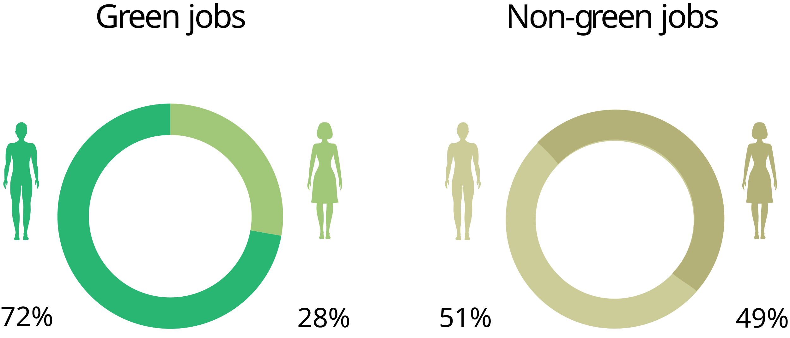
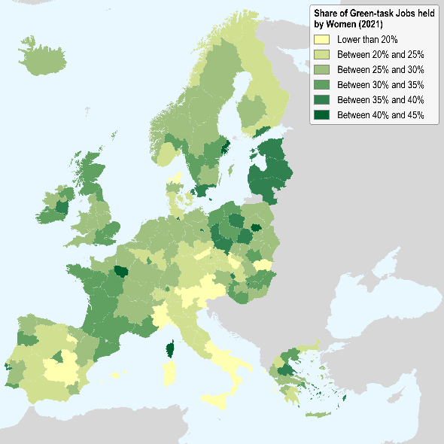
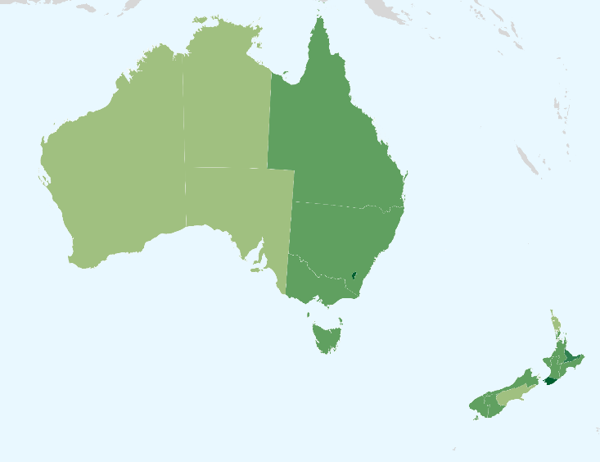
Divides by gender
In a subset of OECD countries, over 20 million women would need to change to green jobs to reach gender parity
Notes:
Women are underrepresented
in green-task jobs (28%).
In all regions in Europe and Australia women constitute less than 50% of the ‘green workforce’.
Men make up the majority of workers
in polluting jobs (>80%).

Slide 8
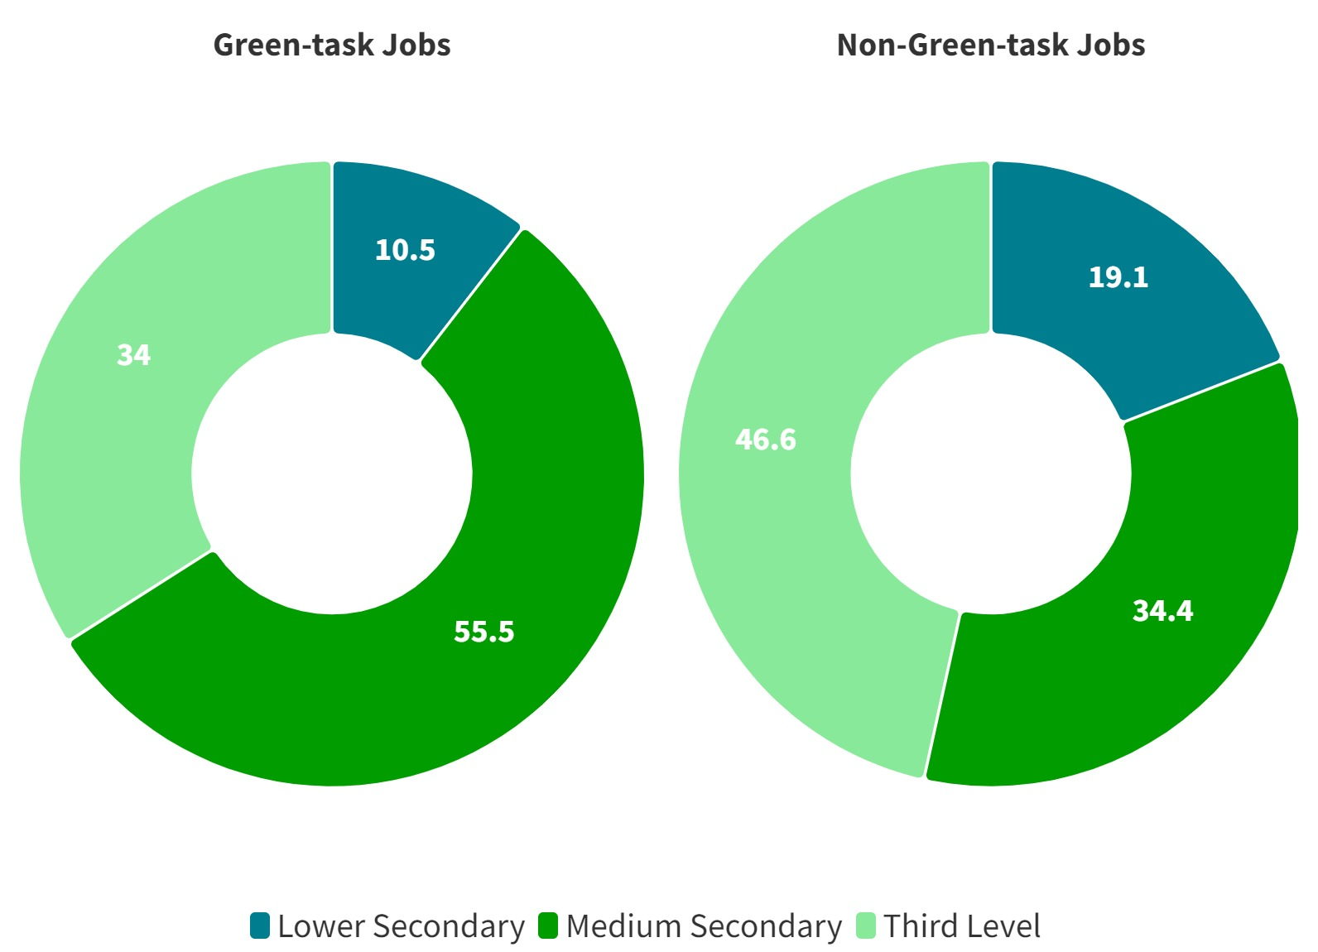


Divides across workers in skills and pay
Employees in green-task jobs have:
Higher average skills levels
20-30% higher wage premium relative to non-green jobs
Workers in polluting jobs are least likely to participate in trainings
Higher levels of formal education
Highly educated workers are over-represented in green-task jobs

Slide 9
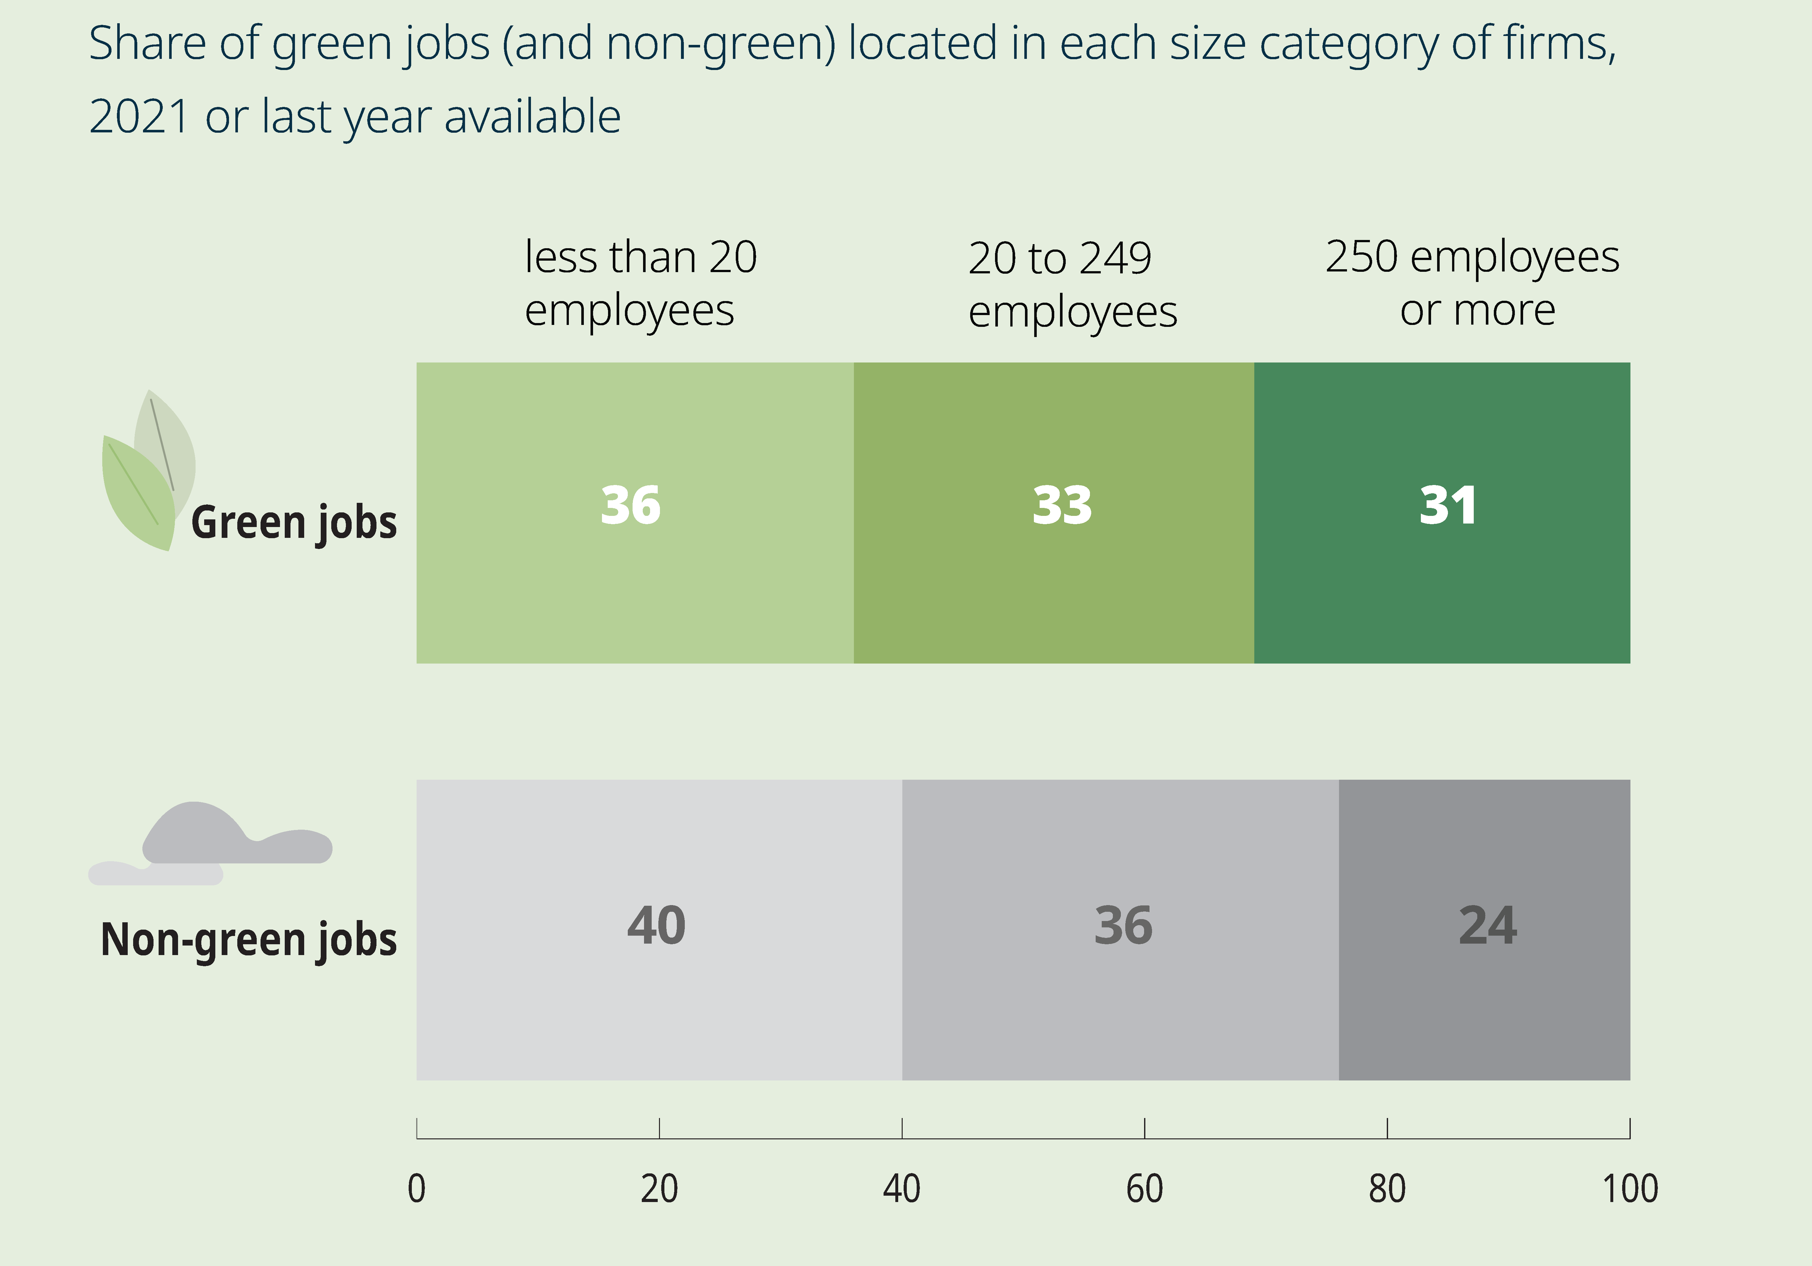

Divides across firms by size, more in large firms
Large firms account for
31% of green jobs,
Higher share than other jobs

Slide 10
What about manufacturing?
Manufacturing among the most polluting sectors
Almost 50% of jobs are polluting jobs
But:
Already a significant share of jobs are green
Large differences across sub-industries
Significant greening potential
Crucial for achieving climate targets
Major bottleneck: labour and green skills shortages

Slide 11




@OECD_local #ChampionMayors
The way forward: actions to bridge the green jobs divide across communities

Slide 12
Local actions for a green future
A
B
Green skills coalitions
for environmental policies to be met with labour market interventions
Labour Market Intelligence that informs effective green policies
E
C
D
Public Employment Services that promote a just transition
Local adult learning systems that help workers adapt to the changing labour market
Local development
efforts that help firms create green jobs and boost local economic growth

Slide 13
What next? Strategic priorities
Scaling up sectors (skills and labour challenges) that drive the green transition:
- Clean tech,
- Enabling technology,
- Sectors under transformation (e.g. automotives, chemicals etc.)
Identifying and understanding green skills gaps and mismatches by sector and region
Supporting career transitions within and out of polluting/declining sectors and jobs

Slide 14

Thank you very much
Dr. Lukas Kleine-Rueschkamp
Coordinator- Local Labour
Market Analysis
lukas.kleine-rueschkamp@oecd.org

